Slide 1


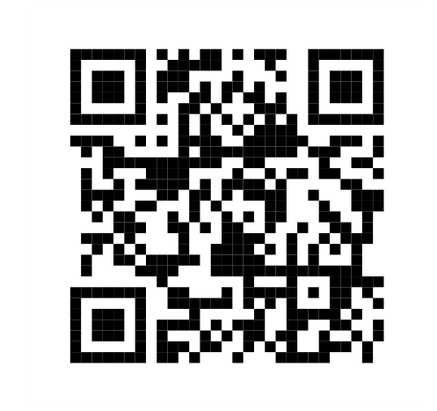
Coin Flipping where weakness is a virtue
https://atulsingharora.github.io/WCF
Joint work with
Jérémie Roland, Stephan Weis and Chrysoula Vlachou
Atul Singh Arora
Notes:
Thank you all for coming. Today I will present what has now become very dear to my heart, coin flipping.

Slide 2
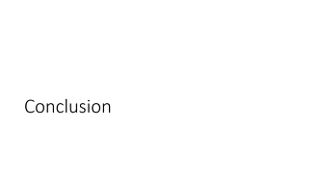
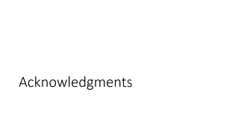
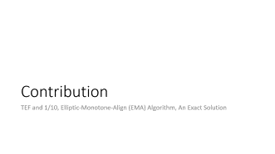

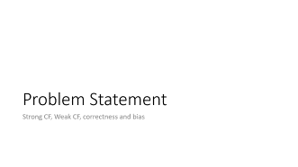
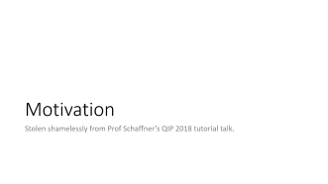
Overview

Slide 3
Acknowledgments
Notes:
So it all started with an ambitious professor at ULB,

Slide 4
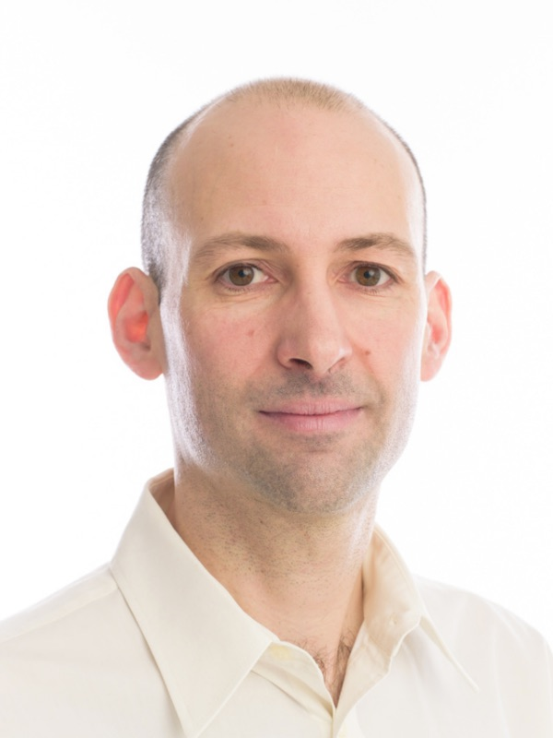
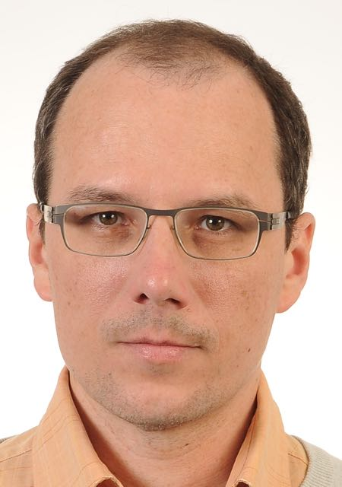
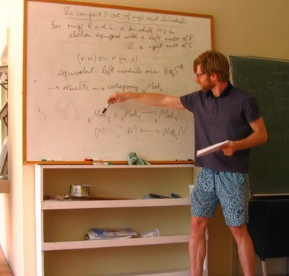
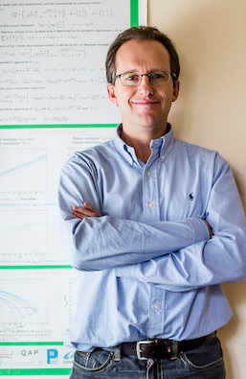
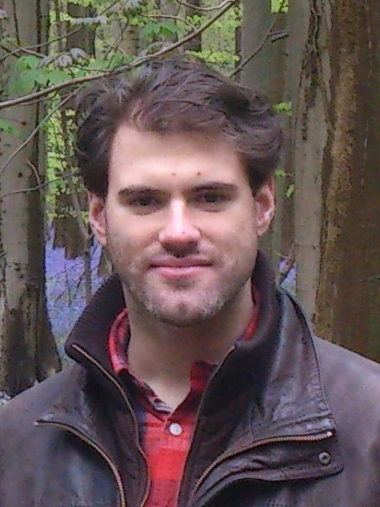






Jérémie Roland*
Stephan Weis*
Chrysoula Vlachou*
Tobias Fritz
Nicolas Cerf
Mathieu Brandeho
* co-authors
Notes:
an expert from another world, a distant kind soul who answered my prayer over stackoverflow, someone I can only describe as man with a curiousity of a child, and a man who will abandon us soon.

Slide 5
Motivation
Stolen shamelessly from Prof Schaffner’s QIP 2018 tutorial talk.
Notes:
We all know what coin flipping is but how can it be of interest to any serious researcher? Consider the following stolen specimen: a silde from Prof Schaffner's QIP talk this year.

Slide 6
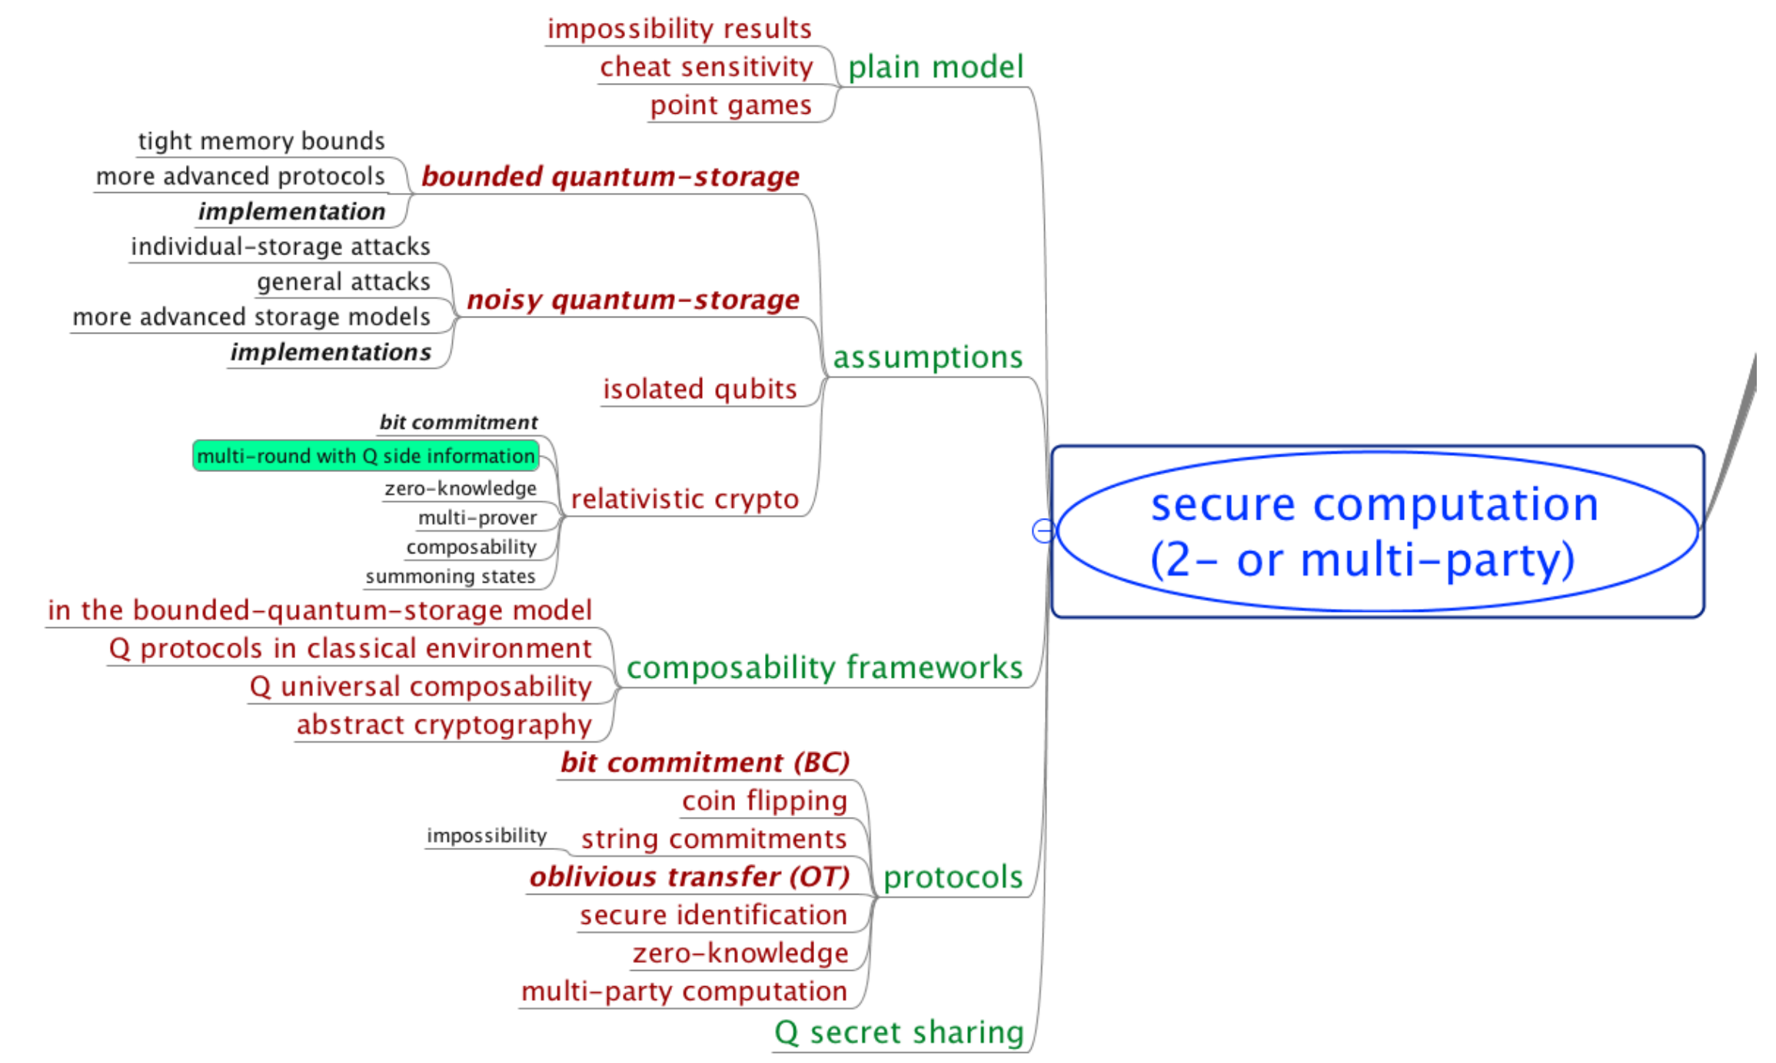
Notes:
See it yet? **[click]** Now?

Slide 7
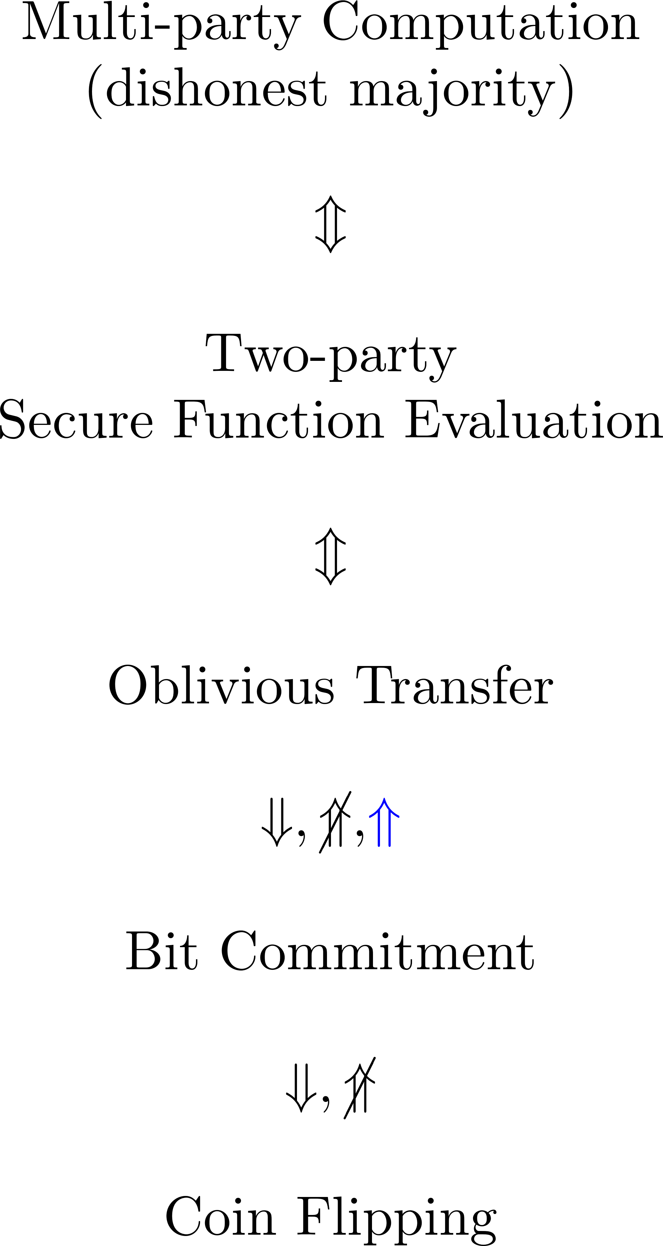
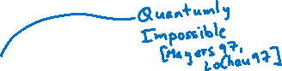

Beyond QKD
Notes:
Recall the setting in Quantum key distribution was that Alice and Bob want to protect against Eve the evesdropper. What if Alice and Bob had a fight, they no longer trust each other? These are the kinds of situations we study in Multi-party computation which involves dishonest player. The protocol must protect an honest player from being cheated.
Many equivalences have been studied all of which are known to be impossible classically, unless one makes computational or other assumptions. The most interesting relation is that of Oblivious transfer and Bit commitment. One can't perform Oblivious Transfer from Bit commitment classically but can quantumly! But that is as far as the quantum magic goes. Turns out Bit commitment itself is quantumly impossible. So, you see where I am going with this? What about coin flipping? Can it be done, whatever it is supposed to be? Is it of any use?
Let us answer some of these questions.

Slide 8
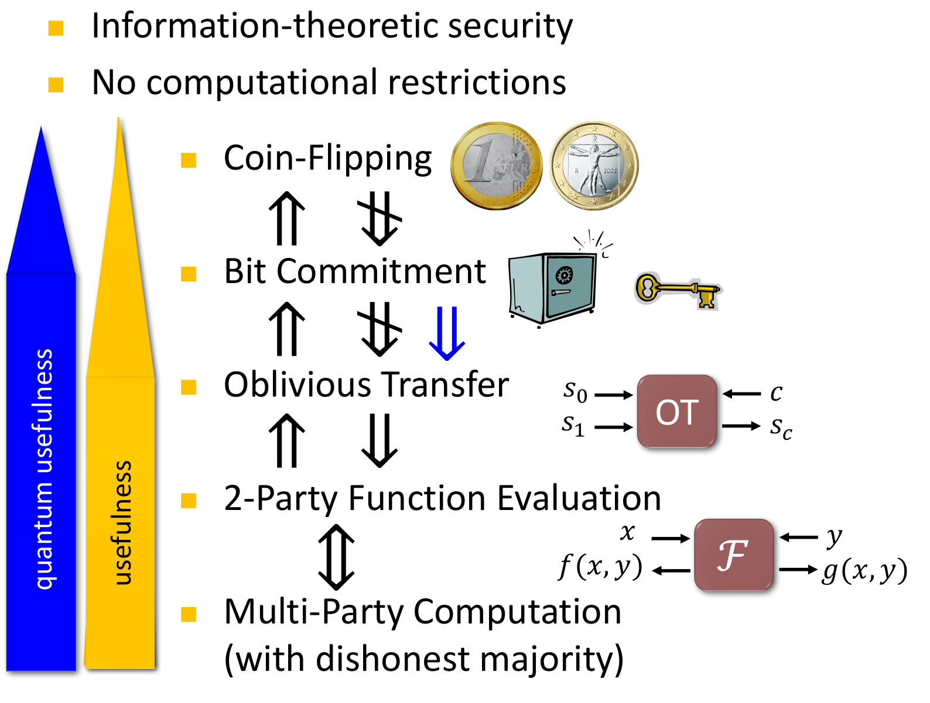
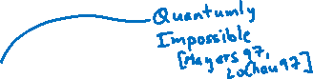

Slide 9
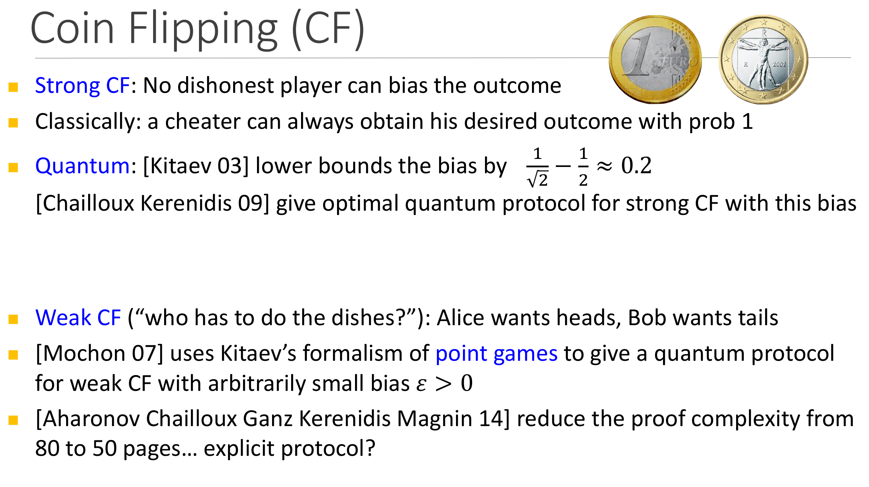

Slide 10
Problem Statement
Strong CF, Weak CF, correctness and bias
Notes:
Let us define the problem first.

Slide 11
Problem Statement
Coin Flipping (CF): Alice and Bob wish to agree on a random bit remotely without trusting each other.
Strong Coin Flipping: No player knows the preference of the other.
Weak Coin Flipping (WCF): Each player knows the preference of the other.

Slide 12
Situations
Honest player: A player that follows the protocol exactly as described.
Alice | Bob | Remark
Honest | Honest | Correctness
Cheats | Honest | Alice can bias
Honest | Cheats | Bob can bias
Cheats | Cheats | Independent of the protocol
Bias of a protocol: A protocol that solves the CF problem has bias ε if neither player can force their desired outcome with probability more than ½+ε.

Slide 13


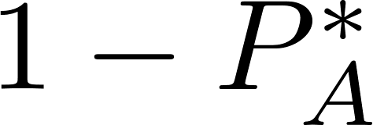
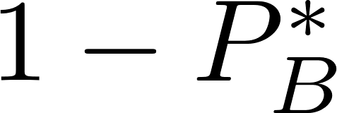
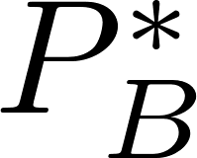
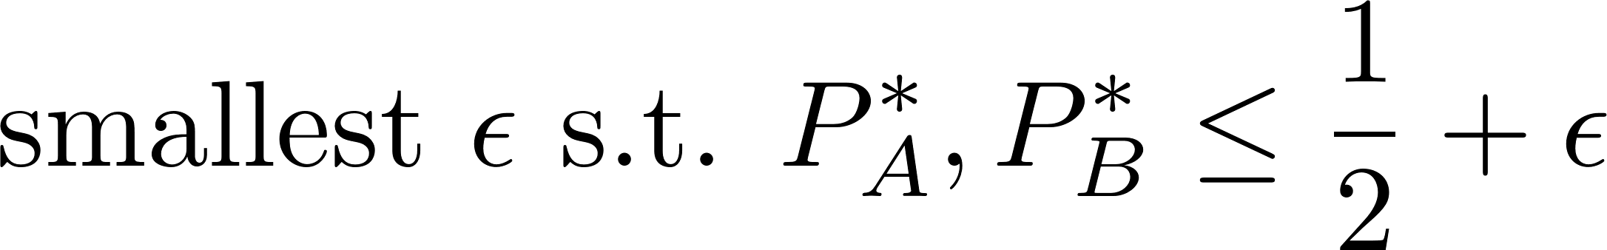
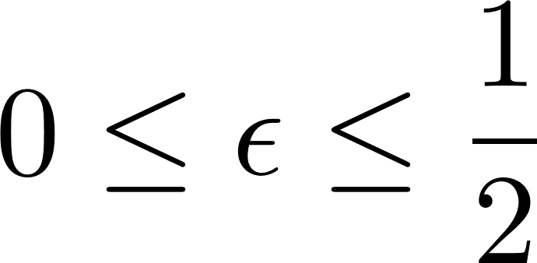
Situations | Weak CF
NB. For WCF the players have opposite preferred outcomes.
Alice | Bob | Pr(A wins) | Pr(B wins)
Honest | Honest
Cheats | Honest
Honest | Cheats
Bias:
NB.

Slide 14
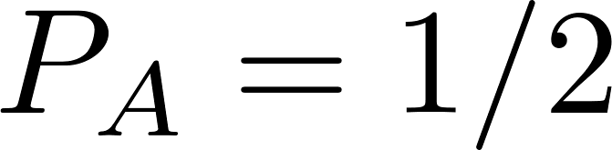
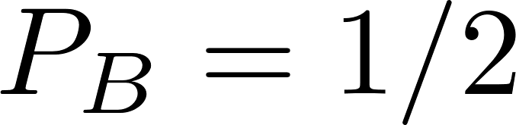
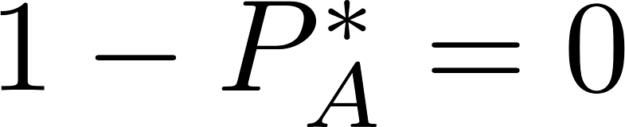
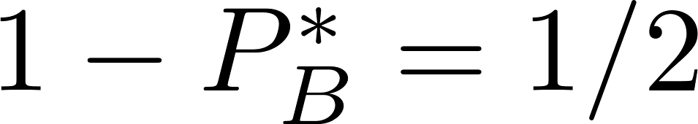
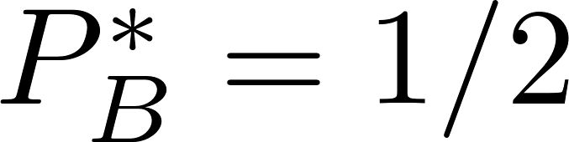
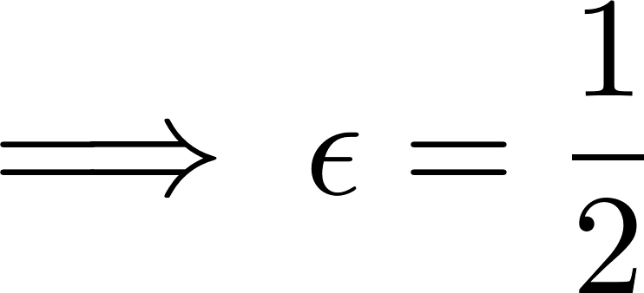
Situations | Weak CF | Flip and declare
Protocol: Alice flips a coin and declares the outcome to Bob.
Alice | Bob | Pr(A wins) | Pr(B wins)
Honest | Honest
Cheats | Honest
Honest | Cheats
Bias:

Slide 15
Prior Art
Bounds and protocols, Kitaev’s Frameworks, Mochon’s Breakthrough

Slide 16
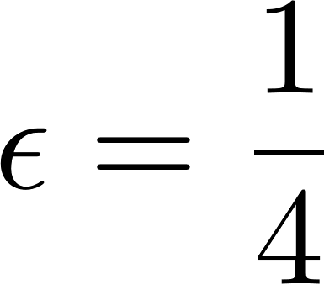
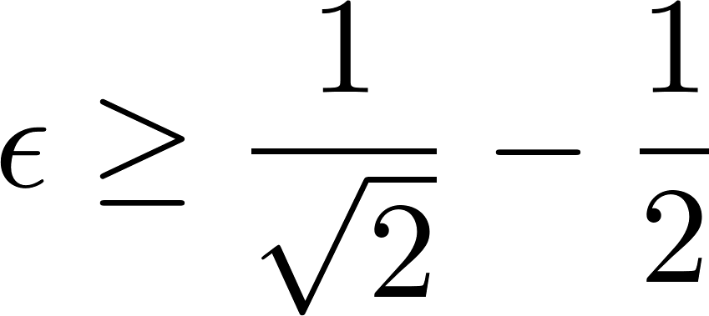
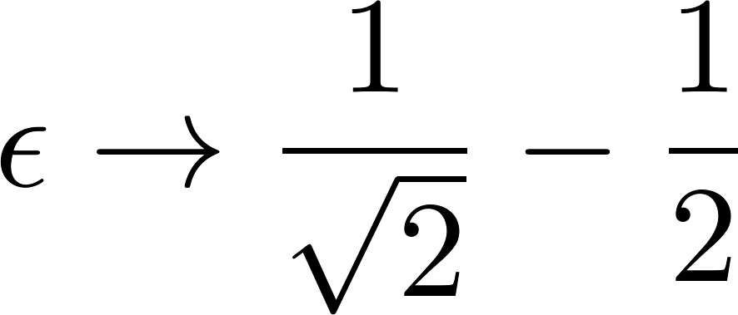
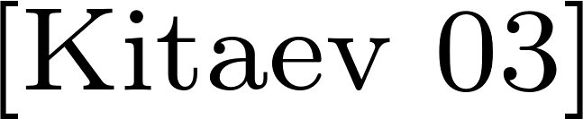
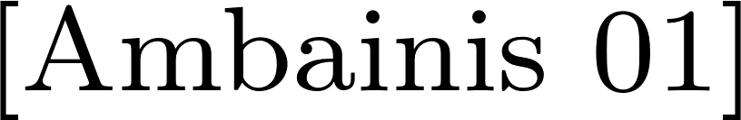
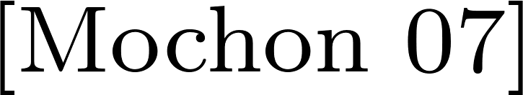
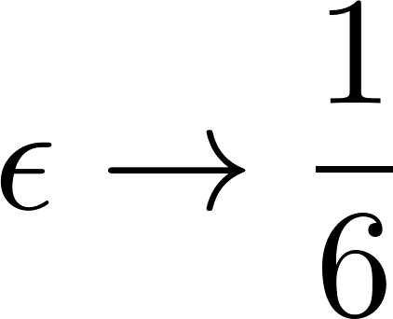
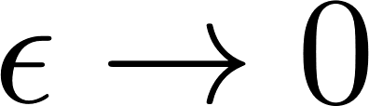
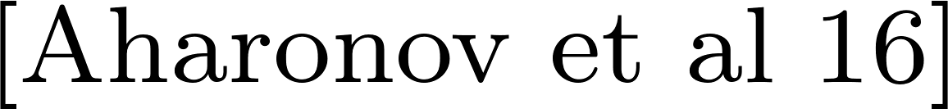
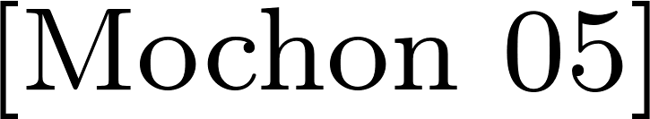
Bounds and Protocols
Classically: viz. at least one player can always cheat and win.
Quantumly:
 | Bound | Best protocol known
Strong CF
Weak CF

Slide 17


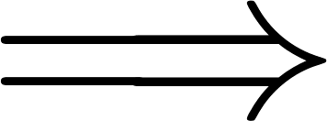
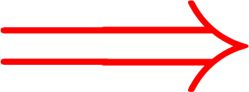
Kitaev | Three Equivalent Frameworks

Slide 18
Kitaev | Three Equivalent Frameworks

Slide 19
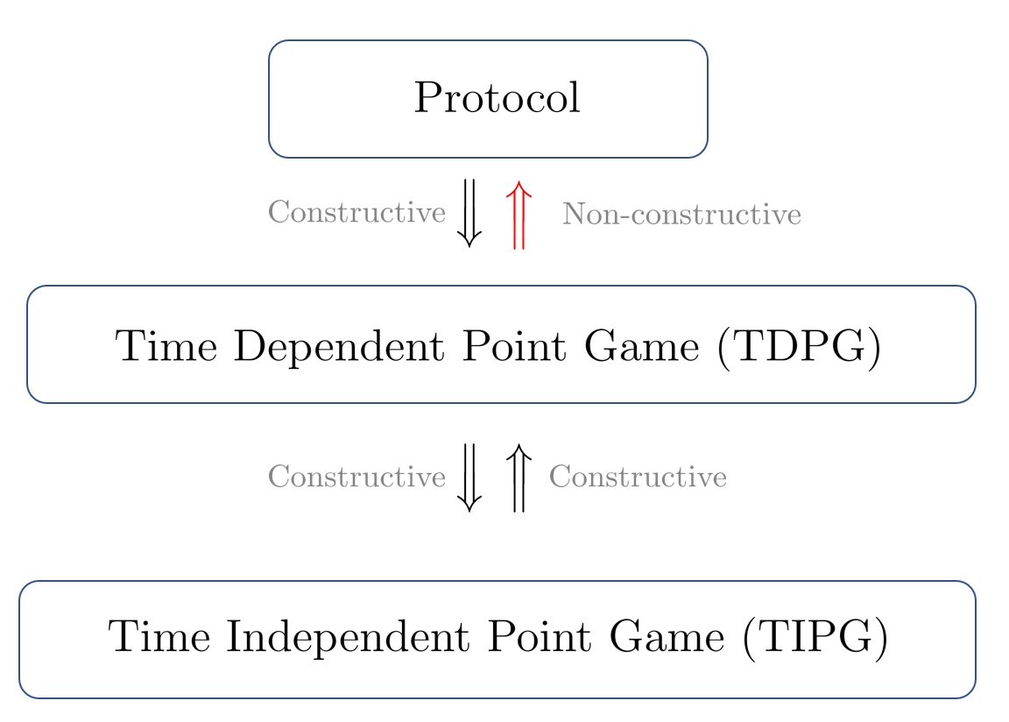
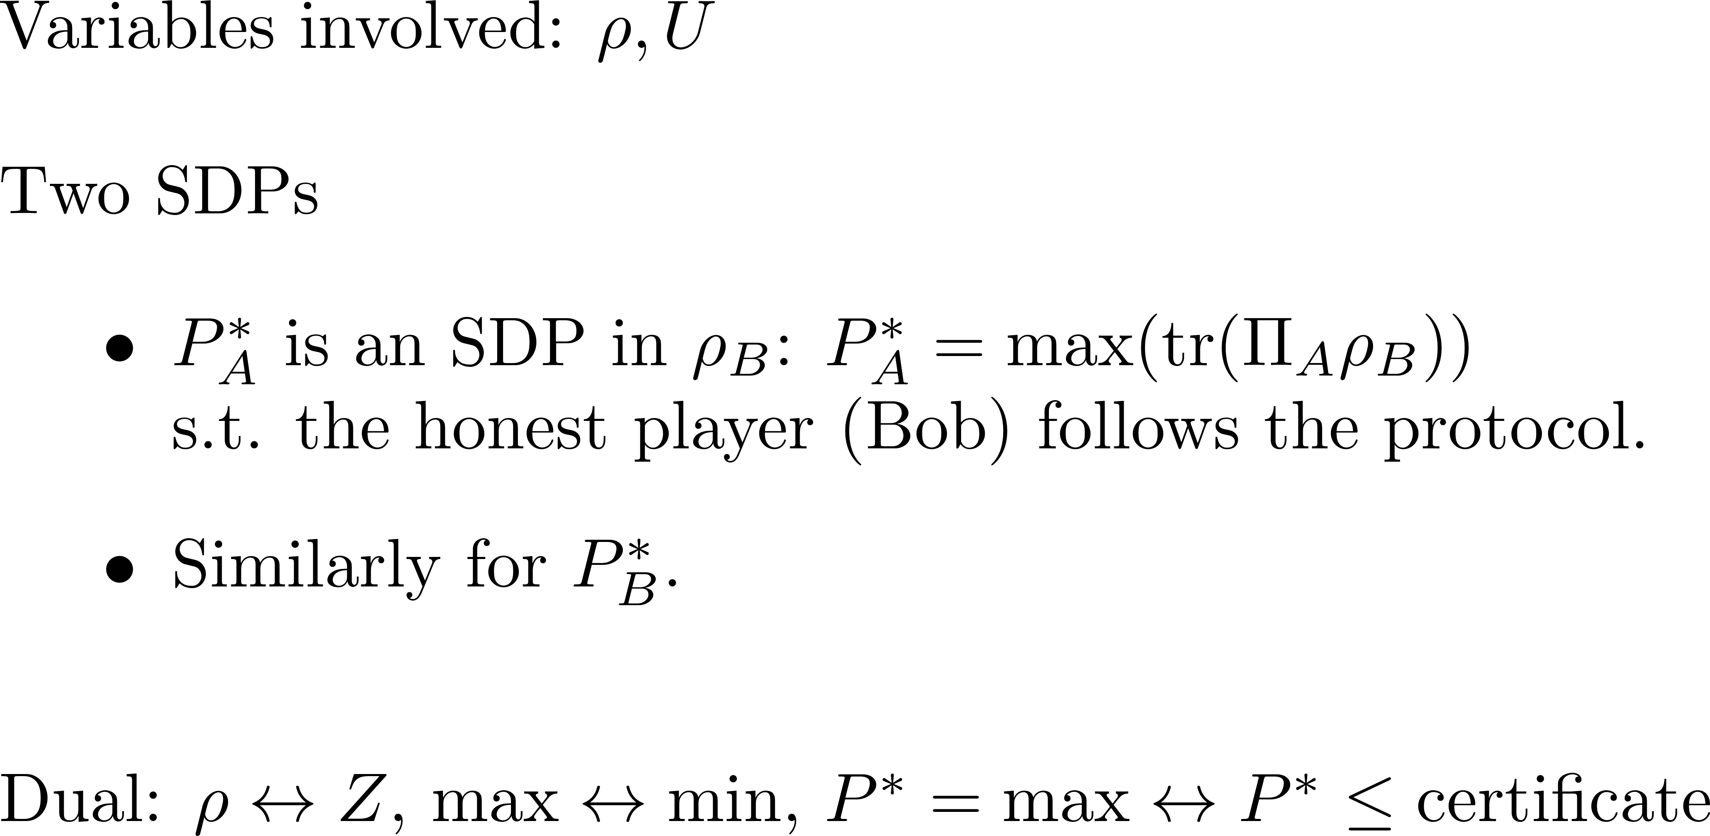
Kitaev | Protocol

Slide 20
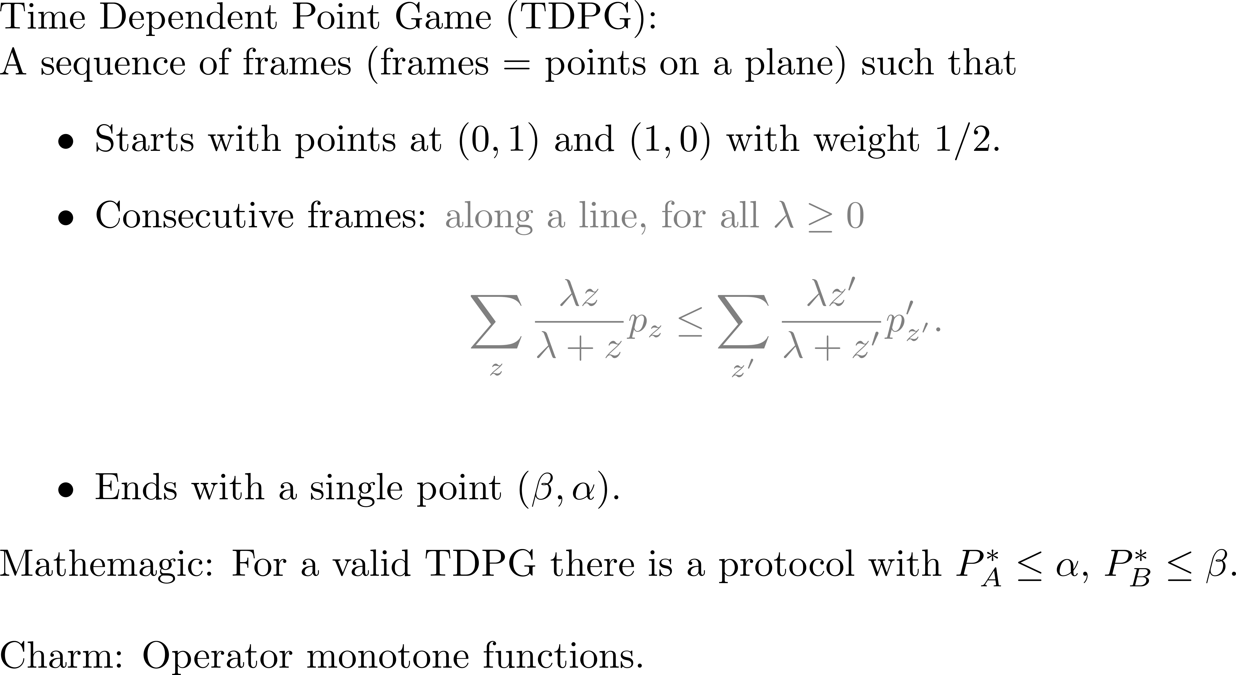
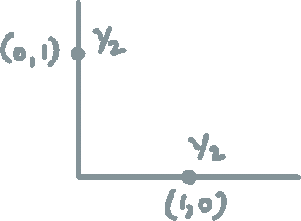
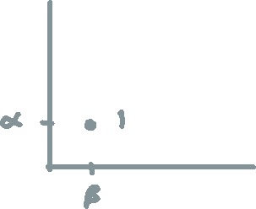
Kitaev | TDPG

Slide 21





Slide 22
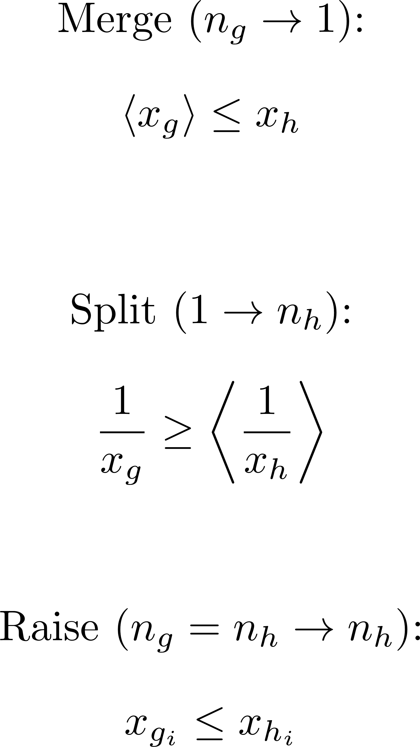
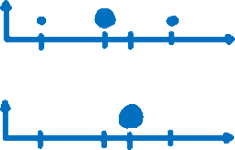
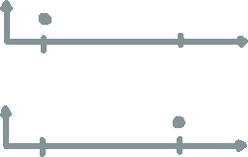
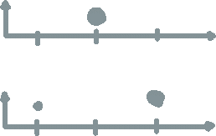
Kitaev’s Framework #2 | TDPG | Rule

Slide 23
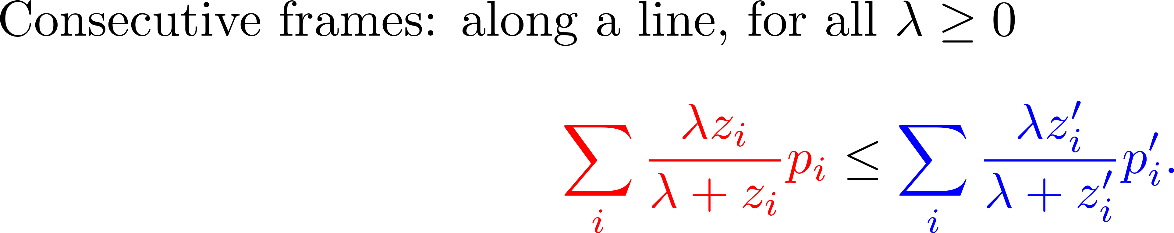



Kitaev’s Frameworks | TDPG | Rule

Slide 24


Kitaev’s Frameworks | TDPG | Rule

Slide 25
Kitaev’s Frameworks | TDPG | Example

Slide 26

Kitaev’s Frameworks | TDPG | Example

Slide 27

Kitaev’s Frameworks | TDPG | Example

Slide 28

Kitaev’s Frameworks | TIPG

Slide 29



Mochon | Near-perfect WCF is possible

Slide 30
Contribution
TEF and 1/10, Elliptic-Monotone-Align (EMA) Algorithm, An Exact Solution

Slide 31

TEF

Slide 32

TEF | Blinkered Unitaries

Slide 33




TEF | 1/10 Explicit

Slide 34


Elliptic Monotone Align (EMA) Algorithm
TEF

Slide 35

EMA | Elliptic Representation

Slide 36







EMA | Elliptic Representation

Slide 37




EMA | Elliptic Representation

Slide 38


EMA | Observations

Slide 39


EMA | Observations

Slide 40



EMA | Elliptic Monotone-Align Algorithm
TEF

Slide 41

An Exact Solution | Mochon’s games

Slide 42
An Exact Solution | Mochon’s games

Slide 43

An Exact Solution | Mochon’s games

Slide 44

An Exact Solution | Challenge
TEF

Slide 45
An Exact Solution | Monomial Assignments

Slide 46
An Exact Solution | Illustration

Slide 47
An Exact Solution | Illustration

Slide 48
Conclusion

Slide 49
Summary
Framework for finding protocols from point games.
Bias 1/10 protocol
Elliptic Monotone Align (EMA) Algorithm—numerical.
Find unitaries for any (strictly) valid move
Protocol for WCF with ε → 0
An Exact Solution
Unitaries for Mochon’s games with ε → 0

Slide 50

Summary
Classically: viz. at least one player can always cheat and win.
Quantumly:
 | Bound | Best protocol known
Strong CF
Weak CF

Slide 51
Outlook
Resources. Compile the 1/10 game into a neater protocol
Structure. Relation between Mochon’s polynomial assignment and the EMA solution
Simpler. Study the Pelchat-Høyer point games and its moves
Robust. Account for noise in the unitaries
EMA will run with finite precision; quantify its effect on the bias
Bounds. Prove lower bounds on number of points needed for achieving a certain bias

Slide 52

?

Slide 53

Thank you
arXiv:1811.02984
The work was funded by FRIA, FNRS; FNRS grant QUICTIME; FNRS grant QuantAlgo.

Slide 54


Resource Requirements

Slide 55






EMA | Big Picture

Slide 56




EMA | Big Picture (cont.)

Slide 57



EMA | EBRM=EBM

Slide 58


Slide 59


Slide 60


Slide 61


